Slide 1
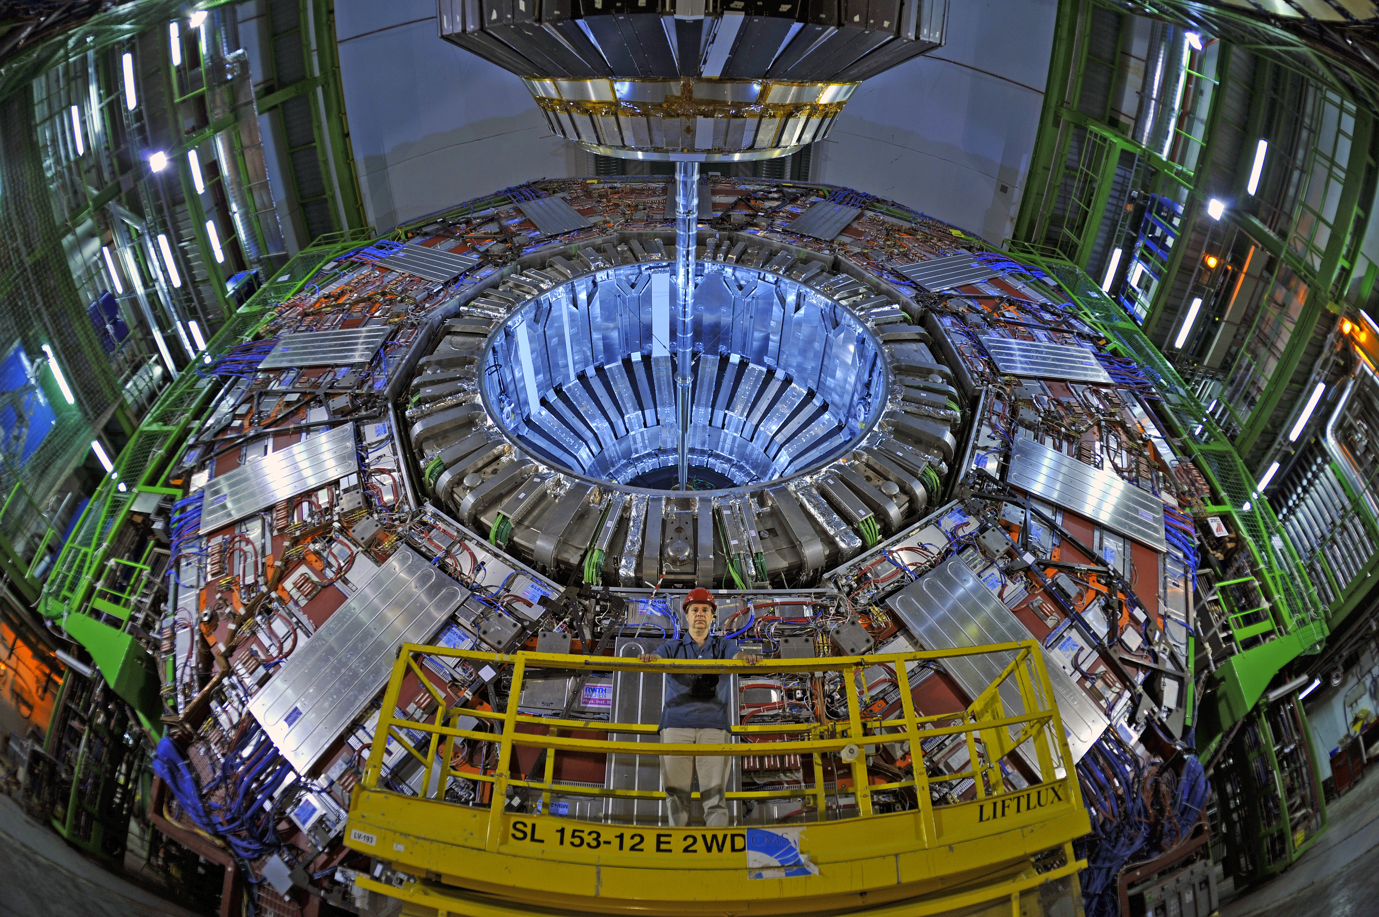
The Higgs Discovery and Beyond
Kevin Stenson
University of Colorado Boulder
November 16, 2016

Slide 2

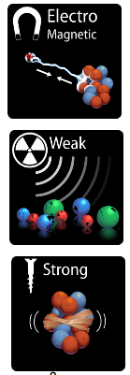
The Standard Model of particle physics (SM)
With the announcement of the Higgs boson discovery on July 4, 2012, all Standard Model particles have been observed.

Slide 3
How do we get electroweak theory?
At low energy we see E&M and weak forces
These are unified at high energy (>1 TeV)
The weak force contains massive force vector bosons (W⁺,W⁻,Z⁰) but directly adding mass terms for W & Z to the theory does not work
Use spontaneous symmetry breaking – the Higgs mechanism
The Higgs mechanism solves two problems:
  Mechanism to give W and Z bosons a mass in such a way as to avoid unitarity violation of WW (or ZZ) cross section at high energy
  Also gives mass to quarks and charged leptons

Slide 4
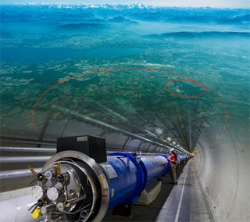
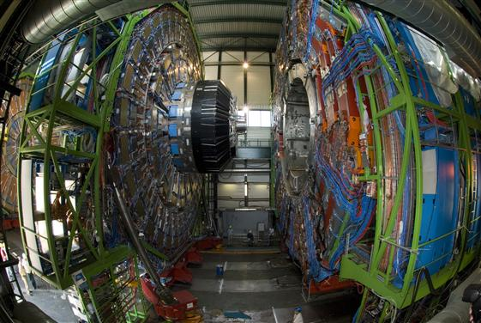
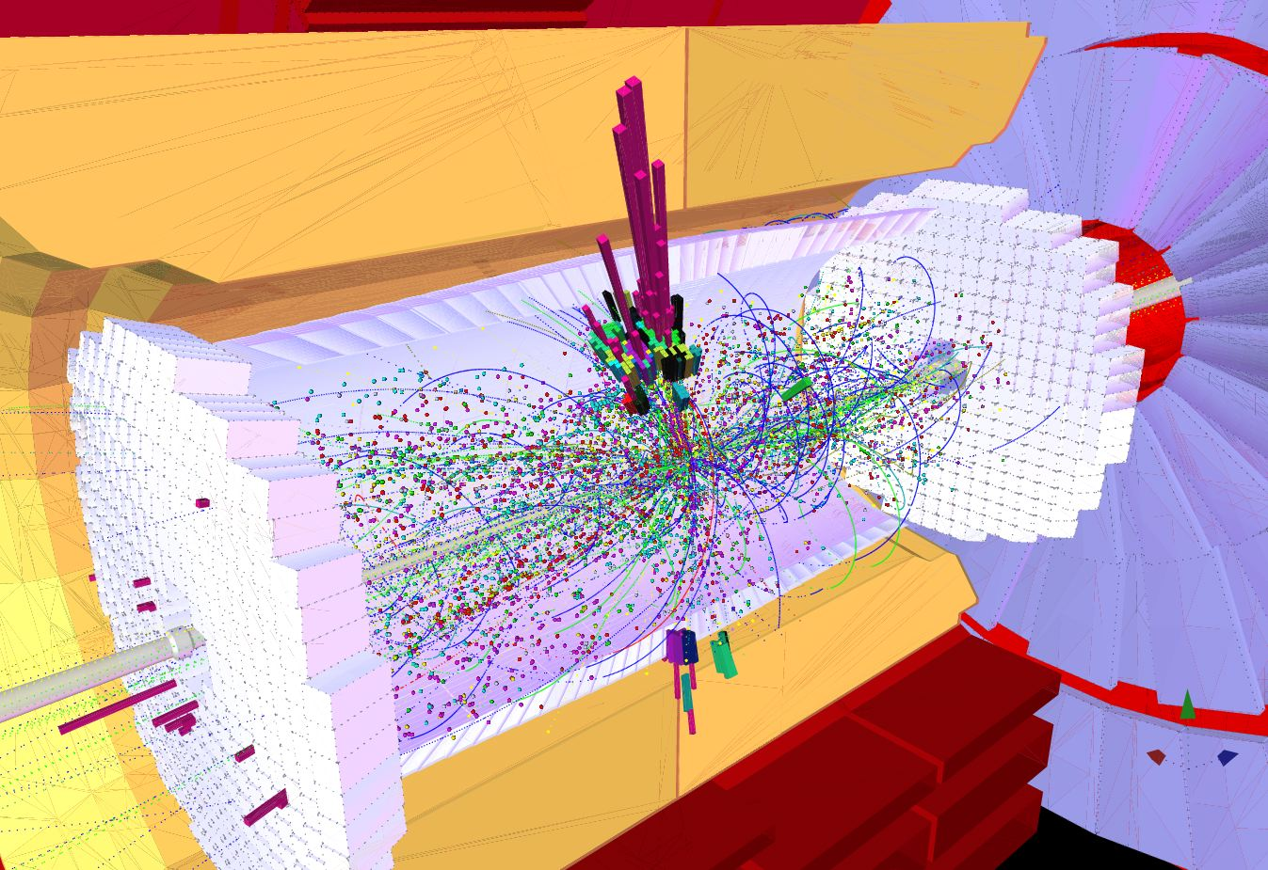
How do we look for new particles?
Need an accelerator to produce the particles.
Need a detector to record the production and decay of the particles.
Need to distinguish interesting events from SM events.

Slide 5
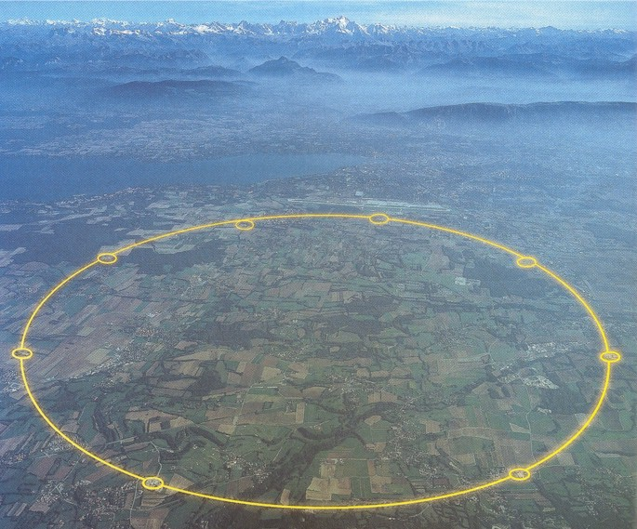
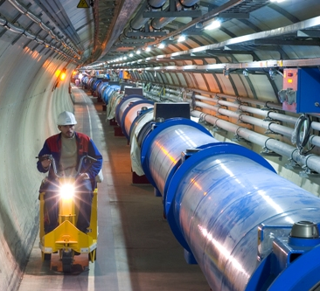
The Large Hadron Collider (LHC)
The LHC is 27 km long and 100-500 feet underground.
Alps
RF cavities accelerate protons to 0.99999999c
Geneva
8.3 T superconducting magnets keep the protons going in circles
Lake Geneva
Geneva airport
CMS

Slide 6
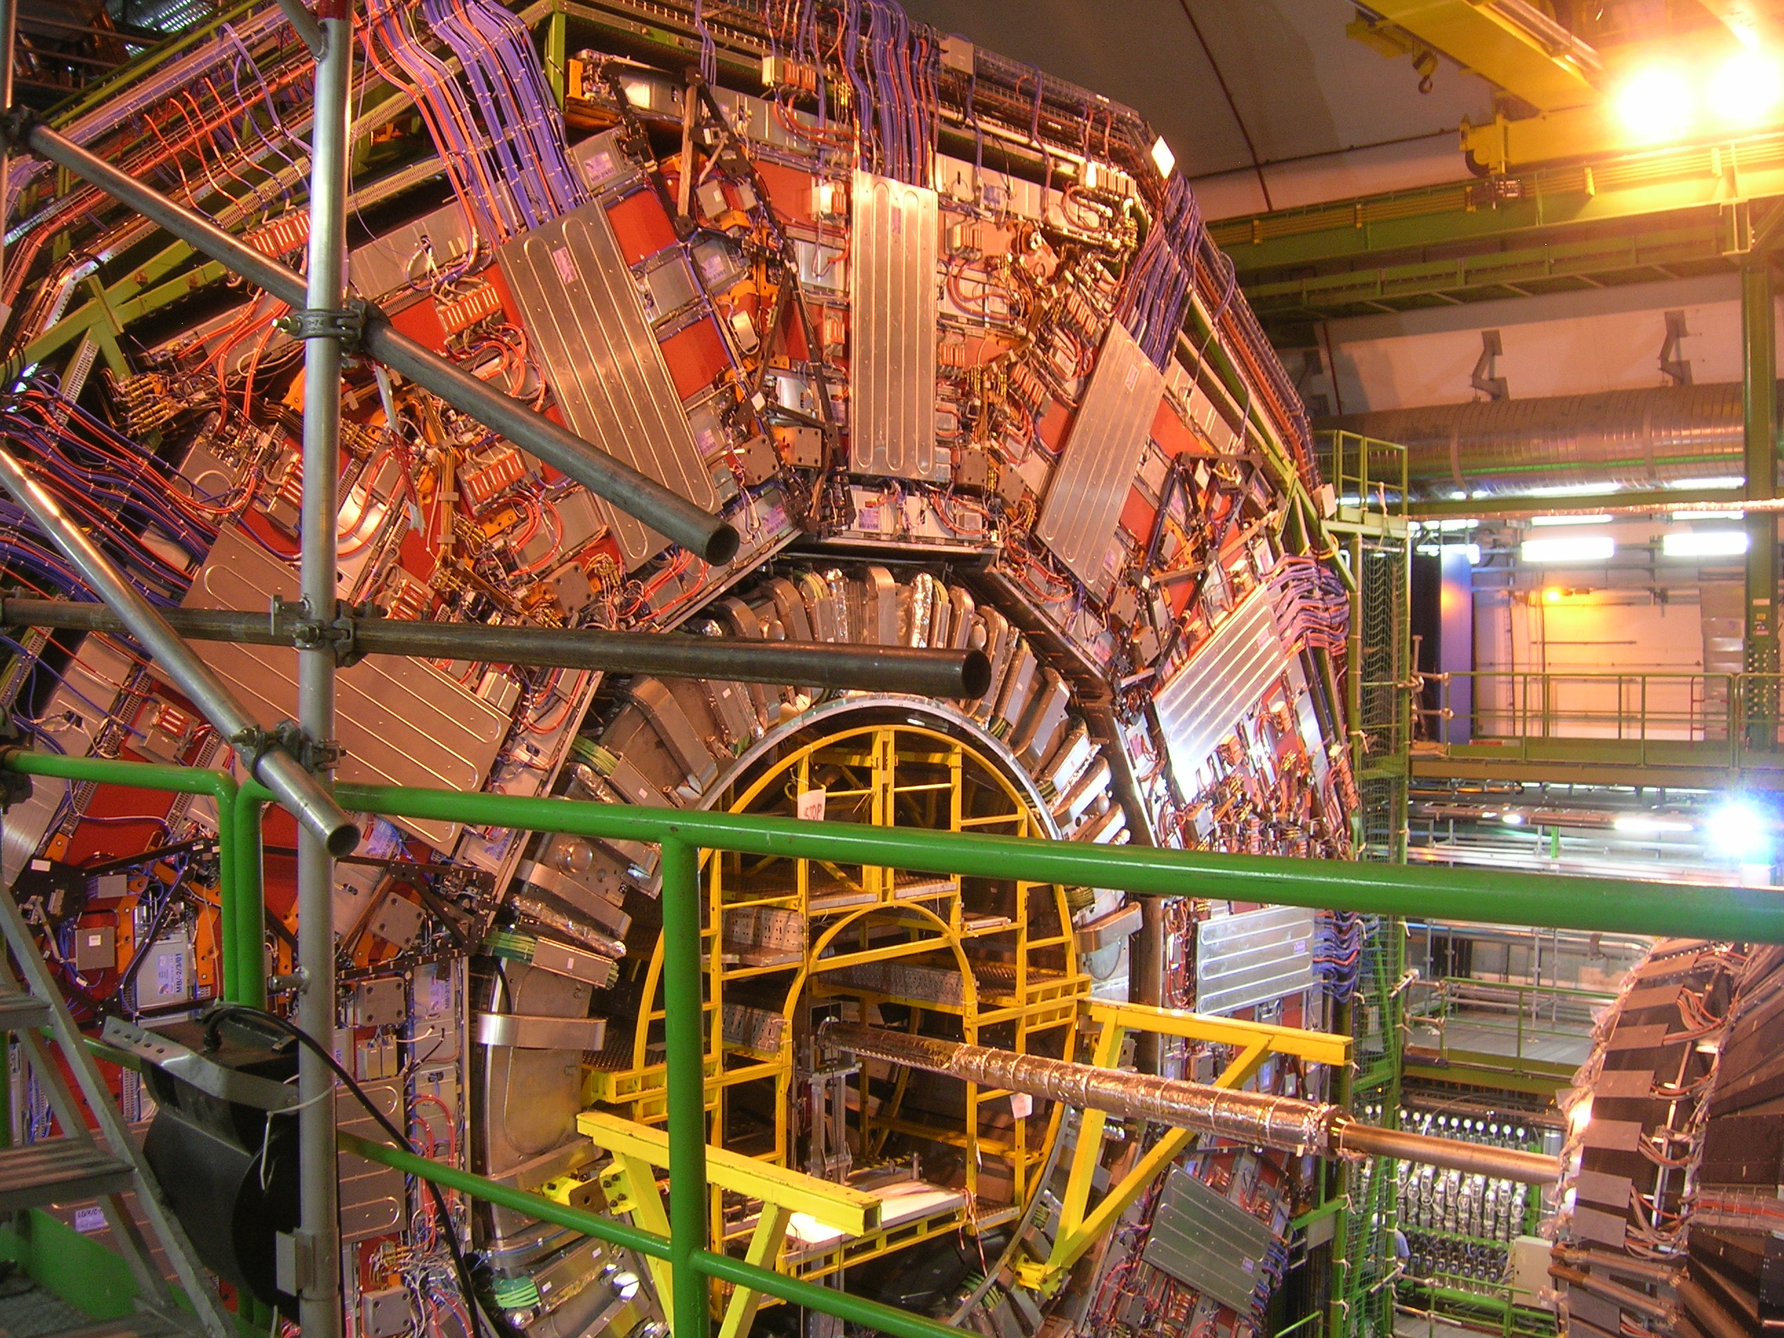
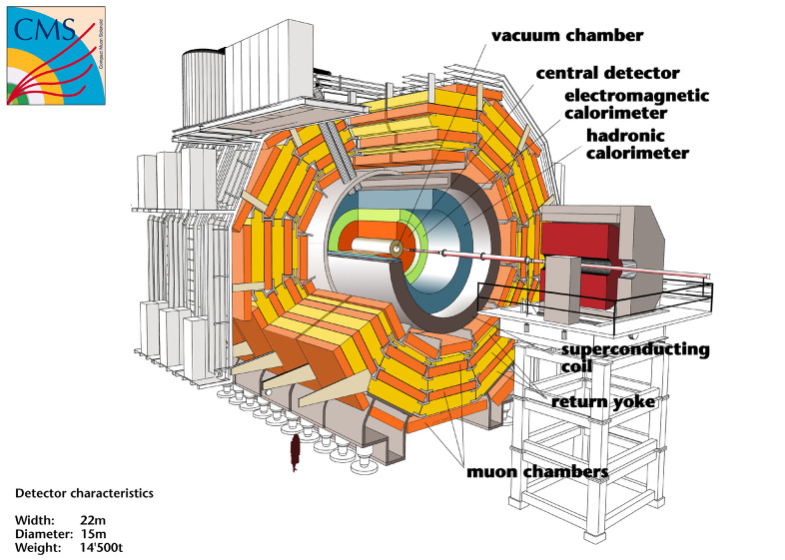
Detecting the particles
We collide protons at high energy to create new particles. But these particles immediately decay into other particles.
Need to detect these particles to reconstruct what happened.
The CMS detector is in a cavern 300 feet underground.

Slide 7
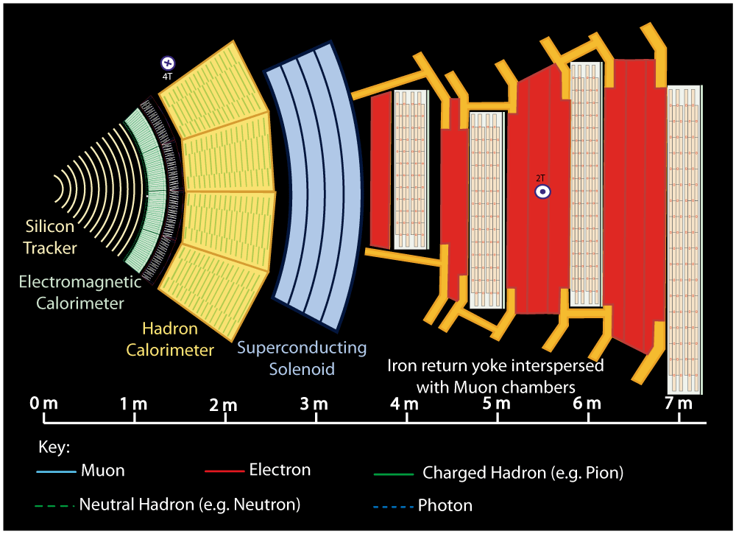

Slide 8
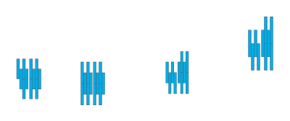



Slide 9
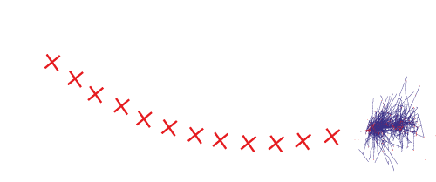



Slide 10
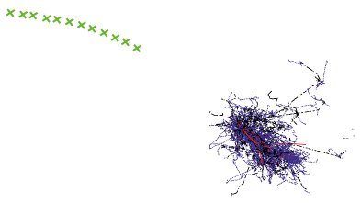



Slide 11
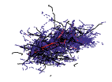


Slide 12




Slide 13
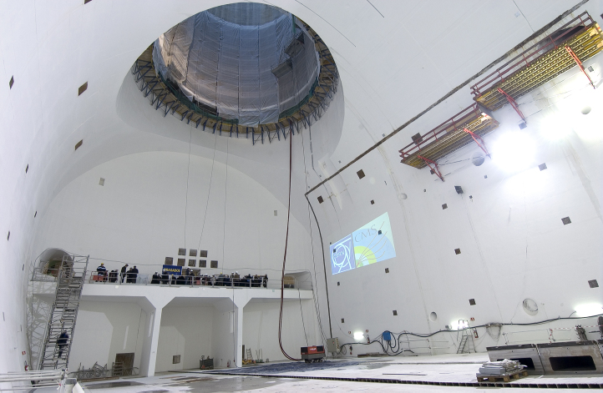
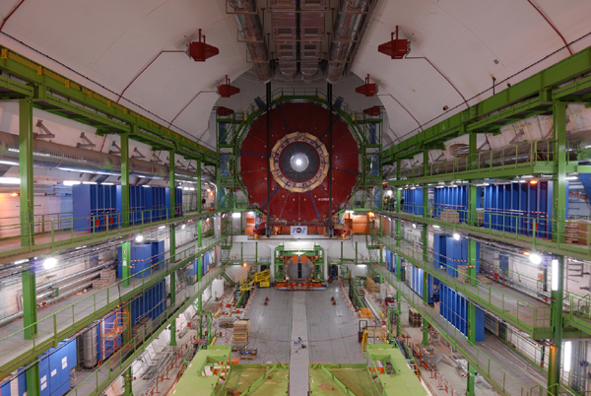
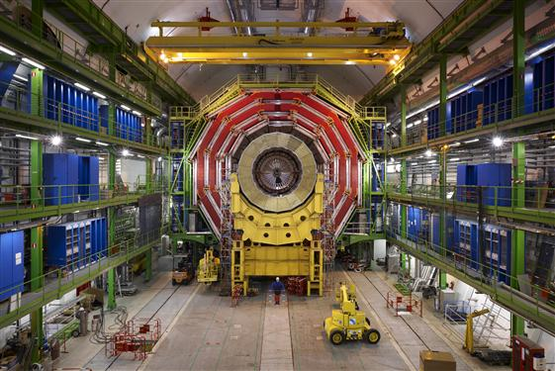
CMS assembly
2005
2006
2007
2008

Slide 14
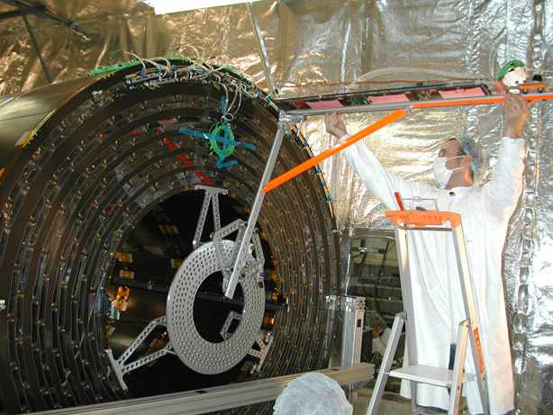
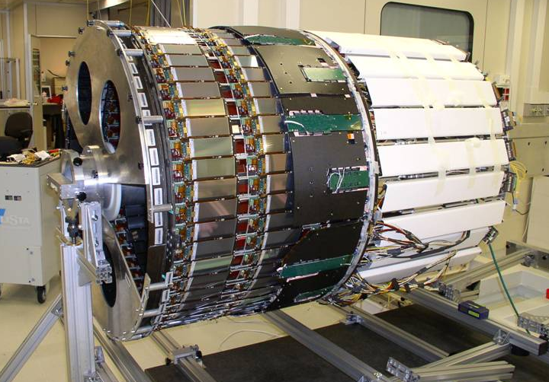
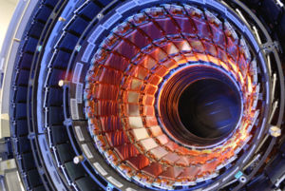

CMS Tracker
Goes inside
CMS tracker uses 2300 square feet of silicon detectors.
CMS tracker being inserted into CMS

Slide 15
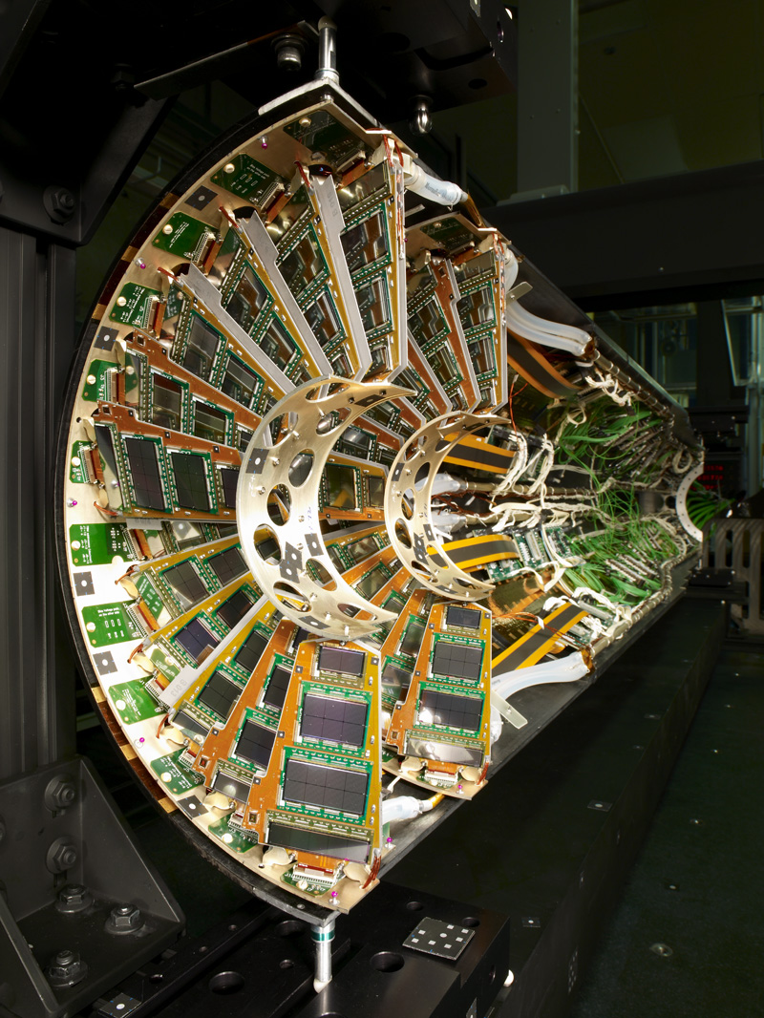
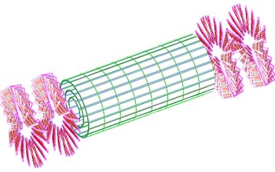
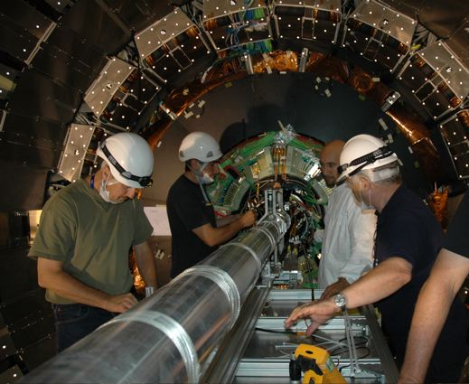
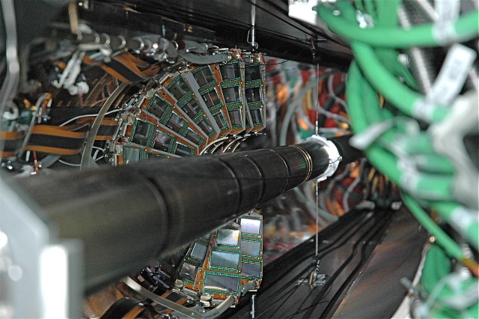
CMS pixel detector
Smallest detector but the most channels. There are 66 million pixels, each 100 μm by 150 μm.
Inserting the detector

Slide 16
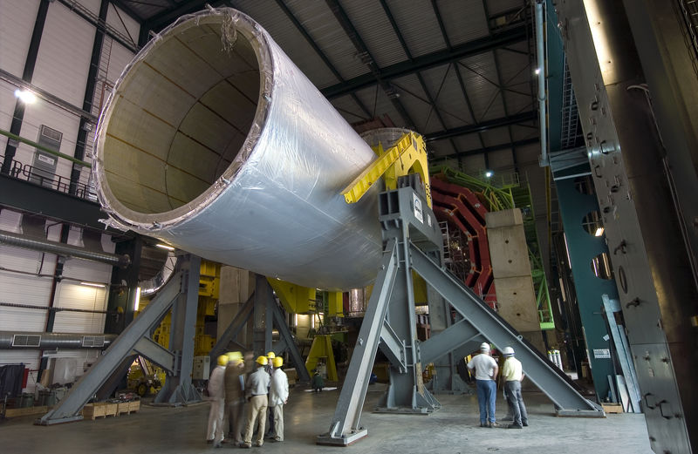
CMS Solenoid
3.8 tesla magnet at 4 K
6 m diameter and 12.5 m long (largest ever built)
220 t (including 6 t of NbTi)
Stores 2.7 GJ — equivalent to 1300 lbs of TNT
If magnet gets above superconducting temperature, energy is released as heat – need to plan for the worst
Bends charged particles allowing tracker to measure momentum

Slide 17
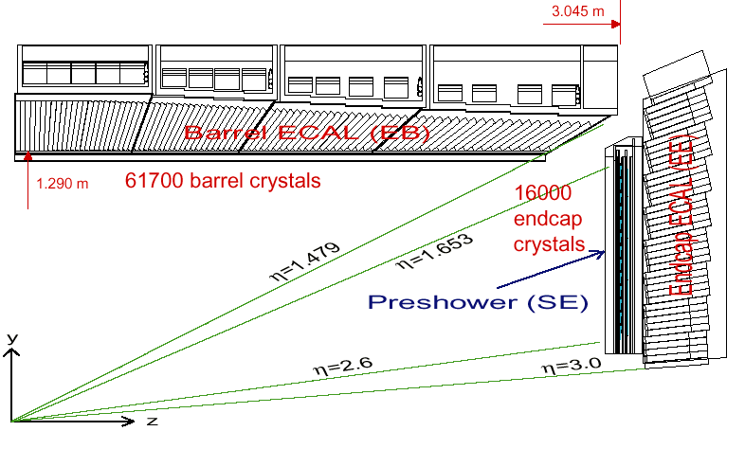
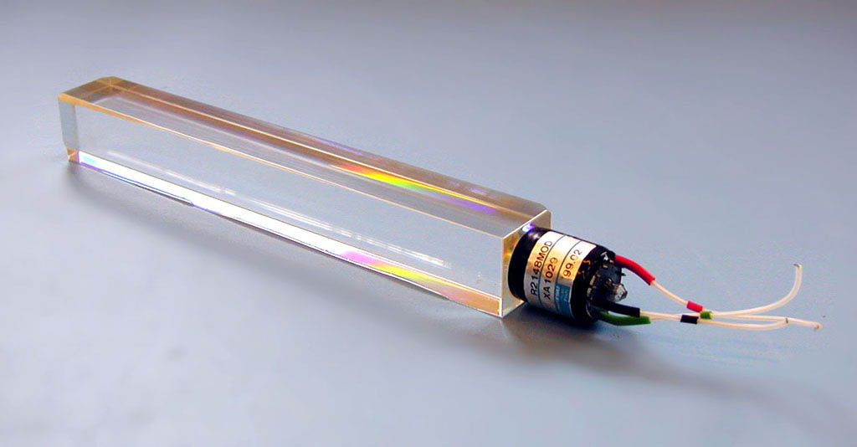
CMS Electromagnetic Calorimeter (ECAL)
Photons and electrons shower in high Z material
Homogenous calorimeter
Lead tungstate (PbWO₄) crystals: 2.3 x 2.3 x 23 cm³
Radiation hard, dense, and fast
Low light yield & temperature sensitivity make it difficult
Magnetic field and radiation require novel electronics APD and VPT

Slide 18
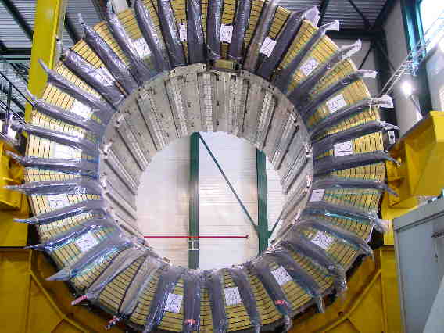
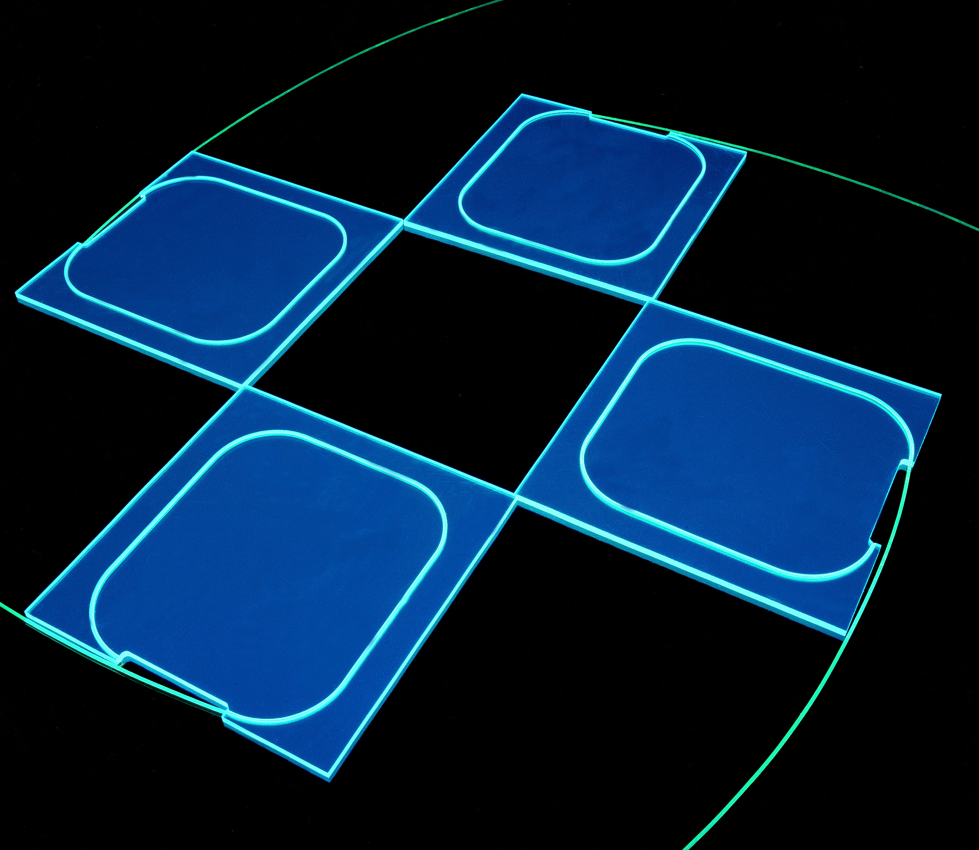
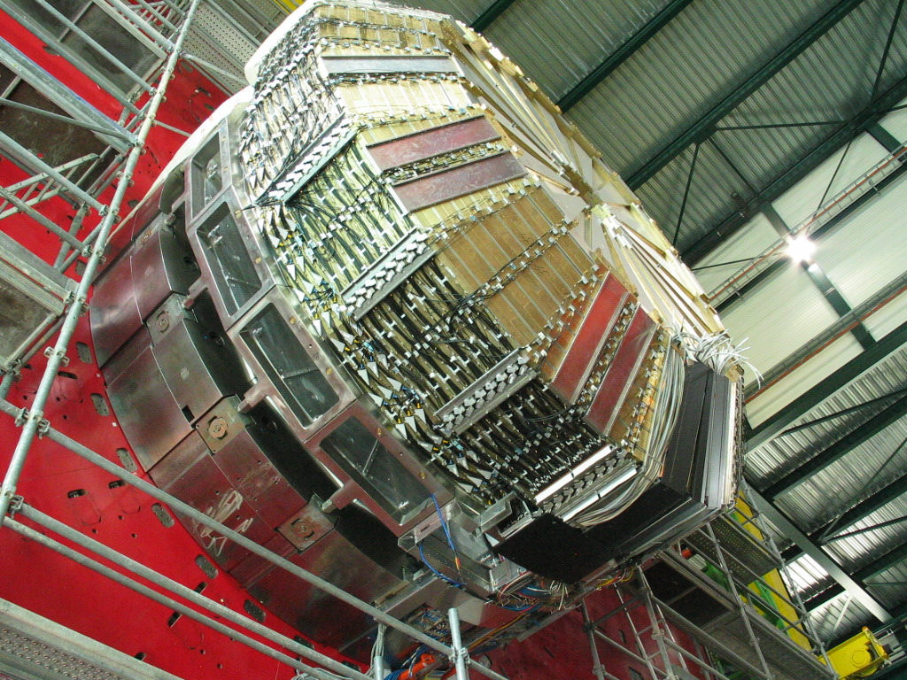
CMS Hadronic Calorimeter (HCAL)
Sampling calorimeter
Brass absorber from Russian artillery shells (non-magnetic)
Scintillating tiles with wavelength shifting (WLS) fiber
WLS fiber is fed into a hybrid photo-diode (HPD) for light yield measurement

Slide 19
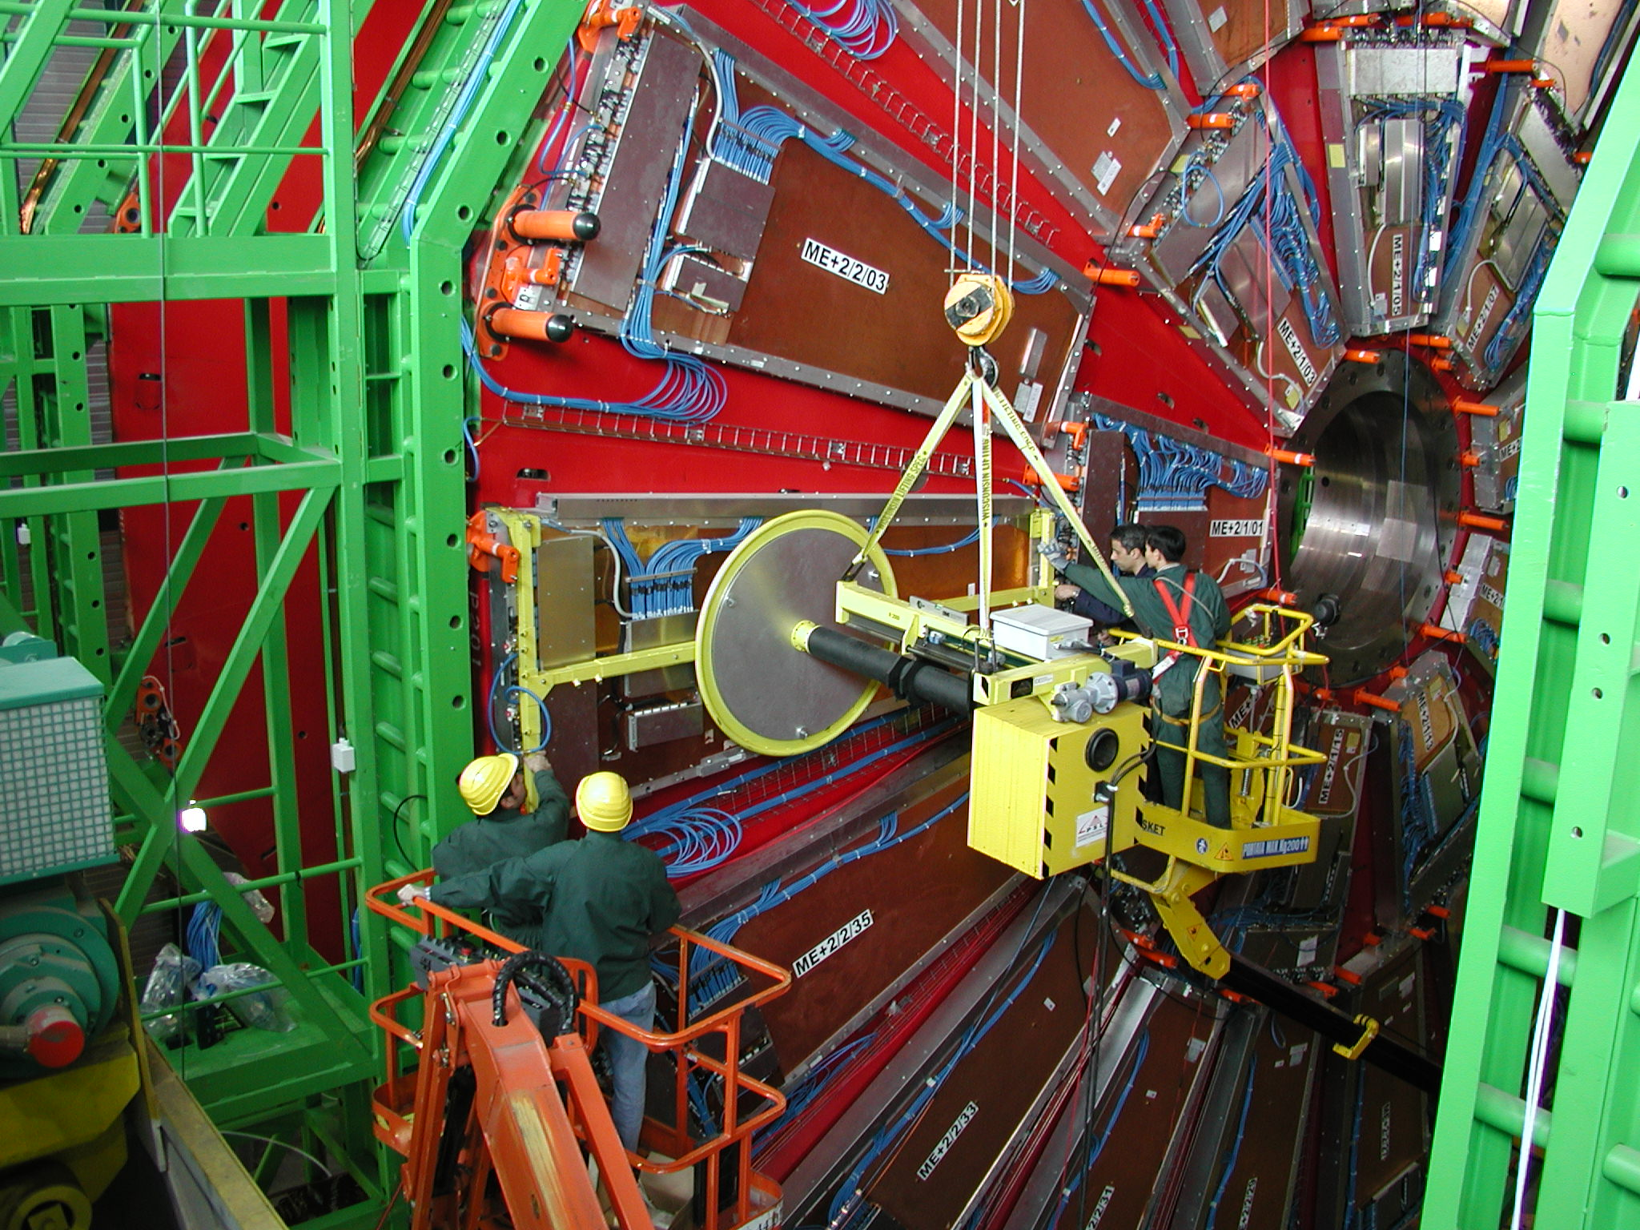
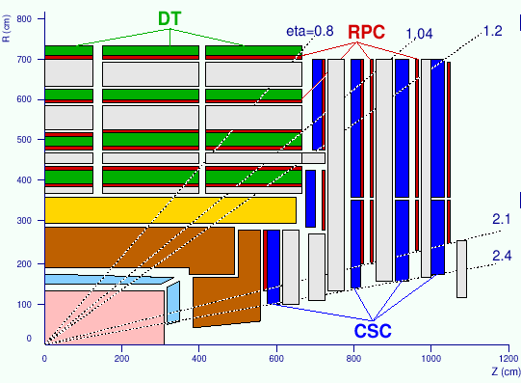
CMS Muon detector
Muons interact less than other charged particles
Place detectors after lots of material so that what comes through must be a muon
Add magnetic field & tracking to find momentum and link with main tracker
12000 t of iron is absorber and solenoid flux return
Three tracking technologies: Drift Tube, Resistive Plate Chamber, & Cathode Strip Chamber

Slide 20
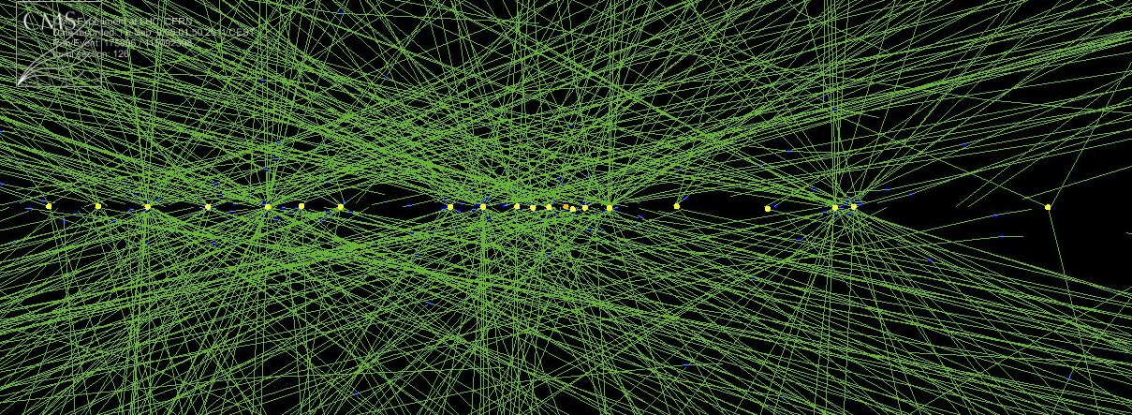
Event selection
Proton bunches collide 40 million times per second, which results in about 40 pairs of protons colliding.
It takes 1 MB of data to record an event.
So we would need to record 40 TB/second to get every event. Not feasible.
Instead, we look at a subset of the information to see if the event is interesting and only put on tape if it is. Still, we save about 1000 events/sec leading to 10 PB/year.

Slide 21
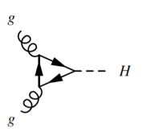
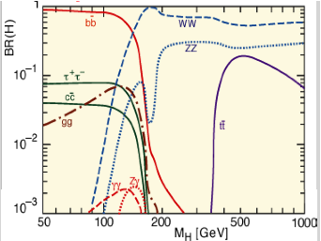
Higgs production and decay
Two gluons inside the colliding protons fuse to make a Higgs boson.
The Higgs is unstable so it decays into other particles, some of which also decay.
  H→𝛾𝛾 and H→ZZ are the most important decay modes.

Slide 22
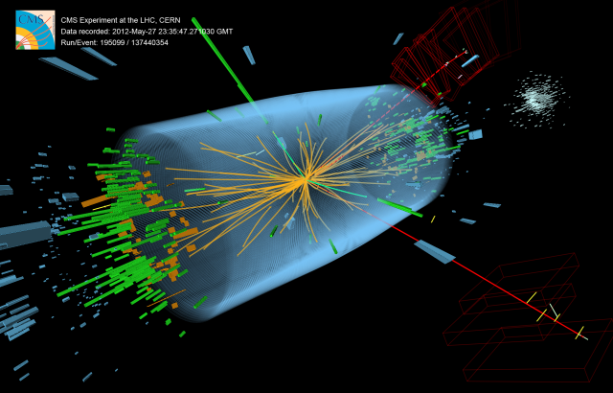
Possible Higgs decay: H→ZZ→ee𝜇𝜇

Slide 23
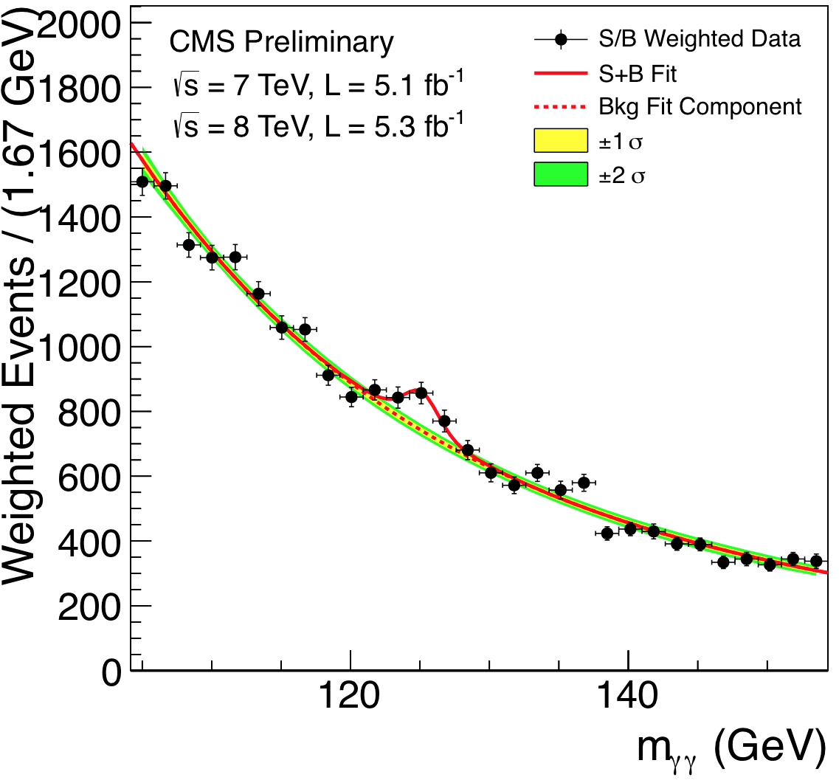
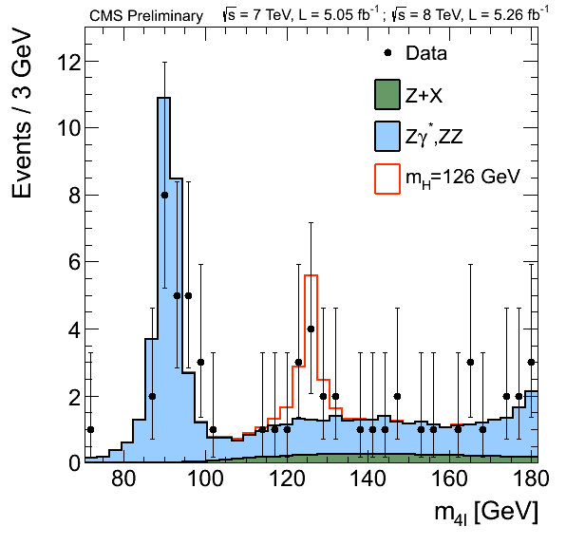
The Higgs discovery
From the July 4, 2012 announcement, evidence of H→ 𝛾𝛾 and H→llll.
Recent results from 2016 data shown in August.

Slide 24
But still lots of questions…
How come the Higgs boson mass is so light?
What is the source of dark matter?
Is there a Grand Unified Theory?
What is the nature of dark energy?
What happened to all the antimatter in the universe?
Why are there 3 generations of quarks and leptons?
How do neutrinos get their mass?
Are neutrinos Dirac or Majorana particles?
What is the quantum theory of gravity?

Slide 25
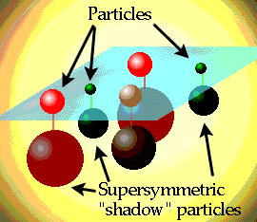
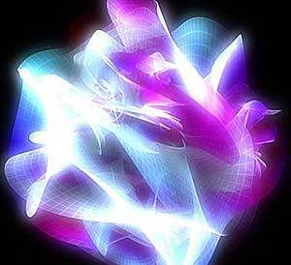
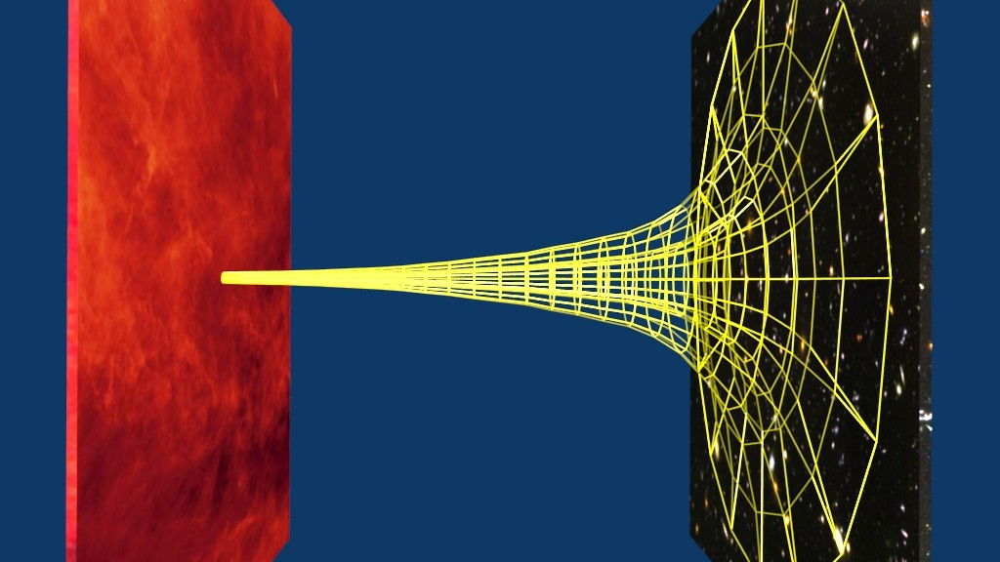
What are the new theories?
It is clear that the Standard Model is incomplete since it can’t answer all the questions we have. Some of the theories we are testing at the LHC are:
  Supersymmetry (SUSY)
  Warped extra dimensions
  Extra particles (matter or gauge particles)
  Low(ish) energy string theory
  Microscopic black holes

Slide 26
Why is the Higgs boson so light?
The SM is known to work up to an energy of ~1 TeV.
It is expected to break down before the Planck scale (10¹⁶ TeV) where quantum gravity should appear.
So the SM cutoff scale, labeled Λ, should be <10¹⁶ TeV
Calculations of the Higgs mass in the SM contain quantum corrections that should result in a mass near Λ. So it is strange to find it at 0.1 TeV.
Solutions to the hierarchy problem:
  The SM is only valid to ~1 TeV and there is a new theory above ~1 TeV.
  There is a fine tuning of the quantum corrections at the level of 1 part in 10¹⁶ (actually 1 part in 10³² since they are quadratic).

Slide 27
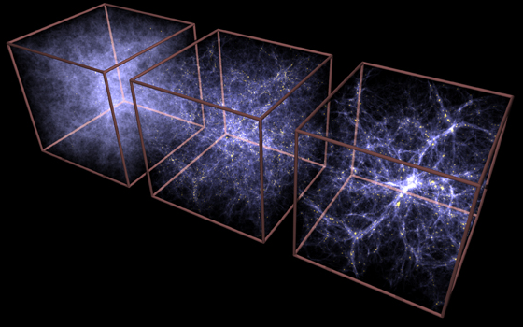
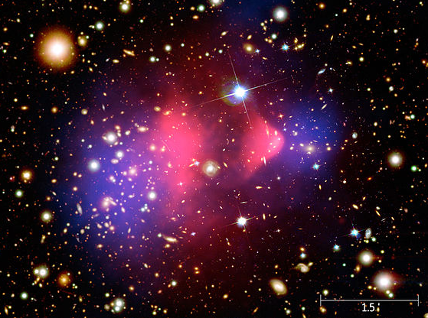
Evidence for dark matter
Galactic rotation curves indicate invisible matter in a spherical halo.
Cosmic microwave background finds more than normal matter.
Gravitational lensing of Bullet Cluster shows dark matter behaves differently than ordinary matter.
Large scale structure of the universe only makes sense with dark matter.

Slide 28
Some dark matter possibilities
Primordial black holes – Created during the big bang before protons are created.
Axions – Light particles with very little interaction with normal matter; proposed to explain lack of CP violation in the strong interaction.
Sterile neutrinos – Masses around keV but not coupling to the Z or other neutrinos.
Weakly Interacting Massive Particles (WIMPs)
  Interact via weak interaction (and gravity) only
  Should have mass ~0.1–1 TeV

Slide 29
WIMPs seem to be an ideal solution
During Big Bang, universe is cooling and expanding.
When T>M_{χ}, the number density of χ particles is constant as creation and annihilation is in equilibrium.
When T<M_{χ}, density drops off exponentially (Boltzman).
As universe expands, particles can’t find each other to annihilate: “freeze-out”.
The cross section needed to get the correct amount of dark matter is the same as the weak interaction. Called the “WIMP miracle”.

Slide 30

Enter Supersymmetry (SUSY)
Proposes an additional symmetry in nature between bosons and fermions.
Each SM particle has a partner particle (sparticle) with same quantum numbers except spin differs by ½.
Cool sparticle names like sbottom, selectron, wino.
Consider R-parity conserving models today: sparticles are produced in pairs and decay to the lightest supersymmetric particle (LSP).

Slide 31
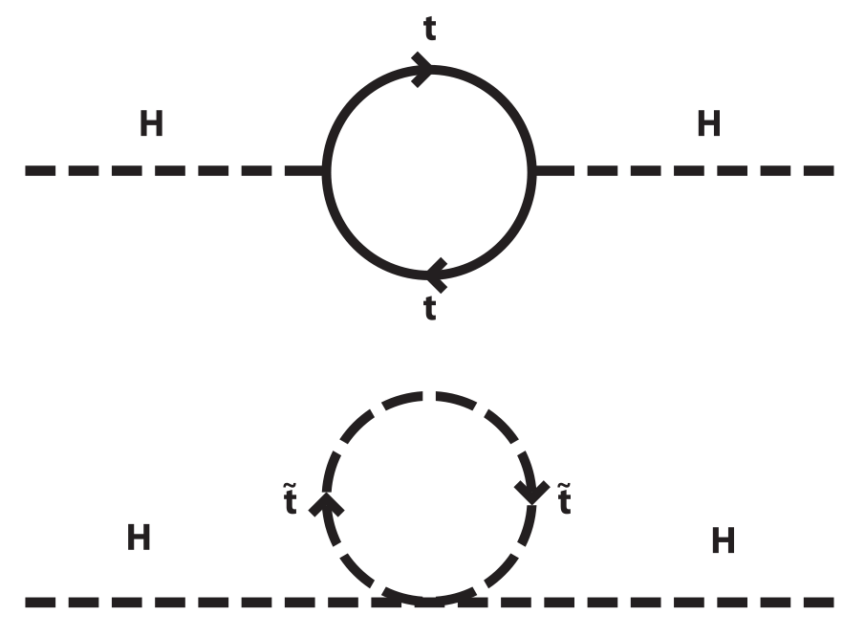
Three good features of SUSY
Can solve hierarchy problem: Quantum corrections from SM particles canceled by the sparticles.
Can provide a dark matter candidate. A neutral LSP will be a WIMP.
The strong, weak, and E&M forces have different strengths (couplings) that change (run) with energy. When the effects of SUSY are included, these couplings converge at 10¹⁶ GeV, keeping alive the hope for a Grand Unified Theory.

Slide 32
The less great features of SUSY
SUSY itself is a well defined theory.
If supersymmetry was a good symmetry, the sparticle masses would be the same as the particle masses.
Since we haven’t found any sparticles, there must be a symmetry breaking mechanism.
This is no problem (already seen – electroweak symmetry breaking is what gives mass to most SM particles).
But we have no idea how the symmetry breaking is done so this opens up all sorts of possibilities – not very predictive.
Need to look as broadly as possible for signs of SUSY.

Slide 33
Search for SUSY in hadronic modes
Search for SUSY involving production via the strong interaction (larger cross section) so produce gluinos or squarks.
Always have 2 LSPs, which exit the detector undetected. In a hermetic detector, this can be seen as large missing transverse energy (MHT).
High mass events produce large amounts of energy seen in the detector (HT).
Each top quark decays to b quark (creating a b jet) and W boson (decaying to two jets 67% of time). Results in many jets (N_{jet}) and b jets (N_{b}).

Slide 34
SM backgrounds for search
QCD : Direct production of many jets with the energy of jet(s) mismeasured, leading to MHT.
Lost-lepton and hadronic τ :Production of W and jets where W decays to e/μ/τ and ν. Neutrino creates MHT. Reduced by rejecting events with e/μ/τ but some may slip through. W bosons can be produced directly or from top quark decays.
Z→νν : Production of Z and jets where Z decays to neutrinos, producing MHT.
These backgrounds are all estimated by using control regions (distinct from signal regions).

Slide 35
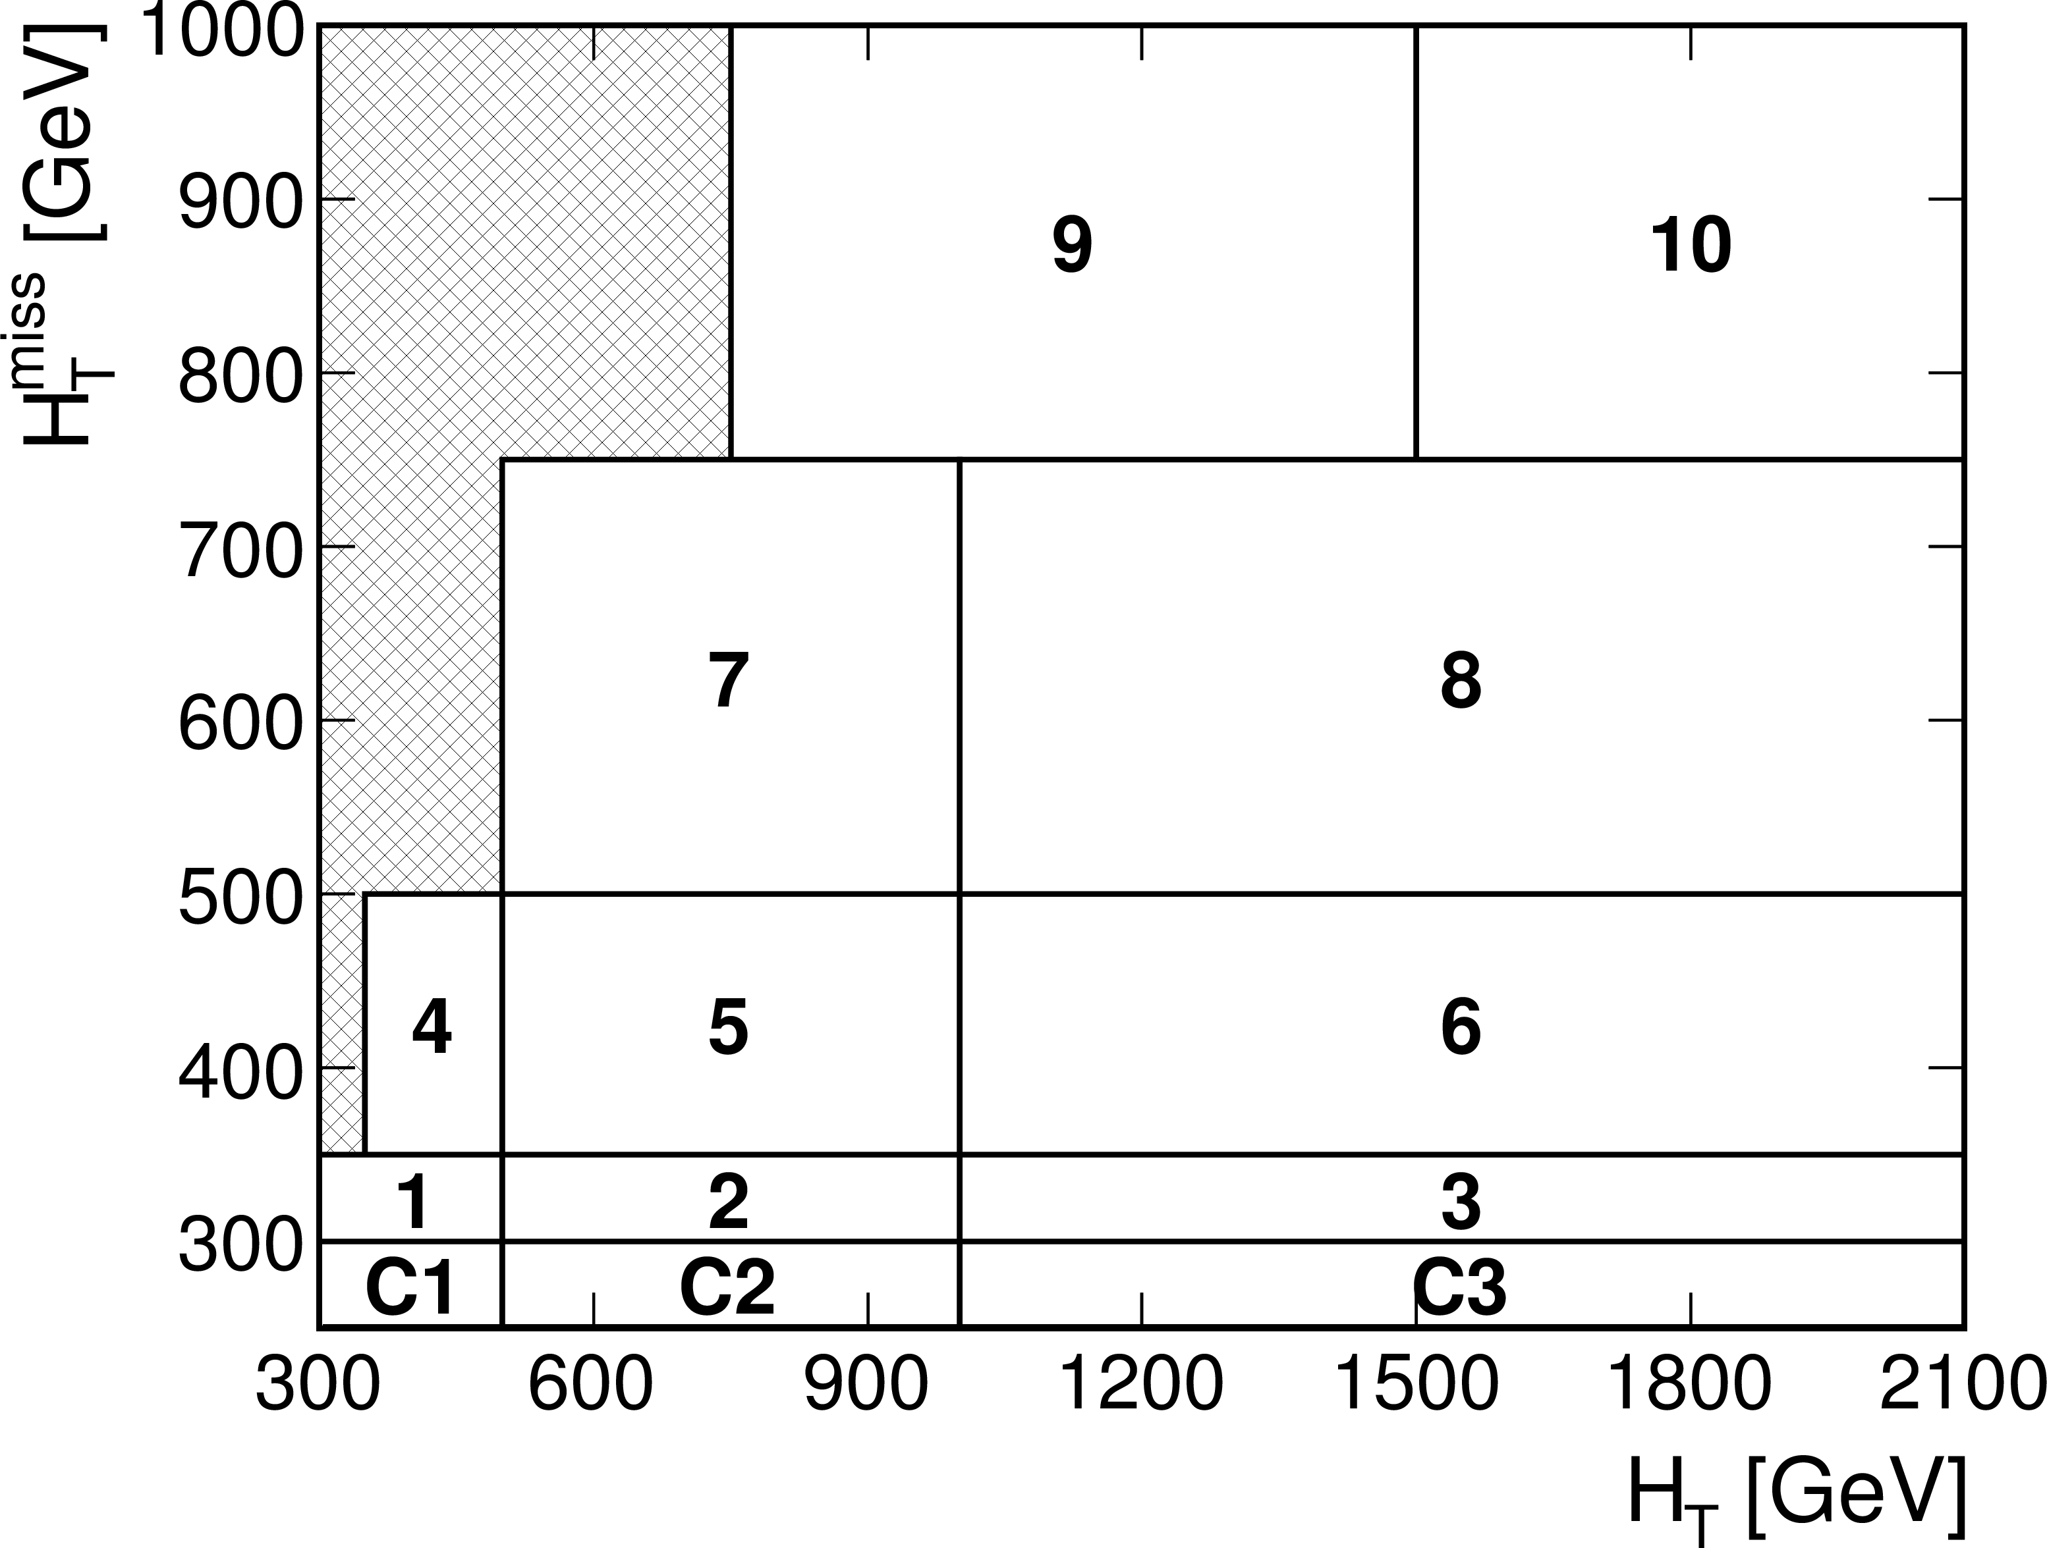
Signal region divided into bins
The HT-MHT plane divided into 10 bins.
4 bins of N_{jet}: 3-4, 5-6, 7-8, 9+.
4 bins of N_{b}: 0, 1, 2, 3+.
Total of 160 bins.
Binning increases the sensitivity and flexibility of the analysis.

Slide 36
Search results
Data is consistent with estimated backgrounds. No sign of SUSY

Slide 37
Limits on SUSY production
Results are presented as regions that are excluded.
Expected limits are what would be obtained if the observed data exactly matched the prediction.
Observed limits in this case are not as good. Could be background was underestimated, statistical fluctuation, or the first sign of SUSY (probably not).

Slide 38
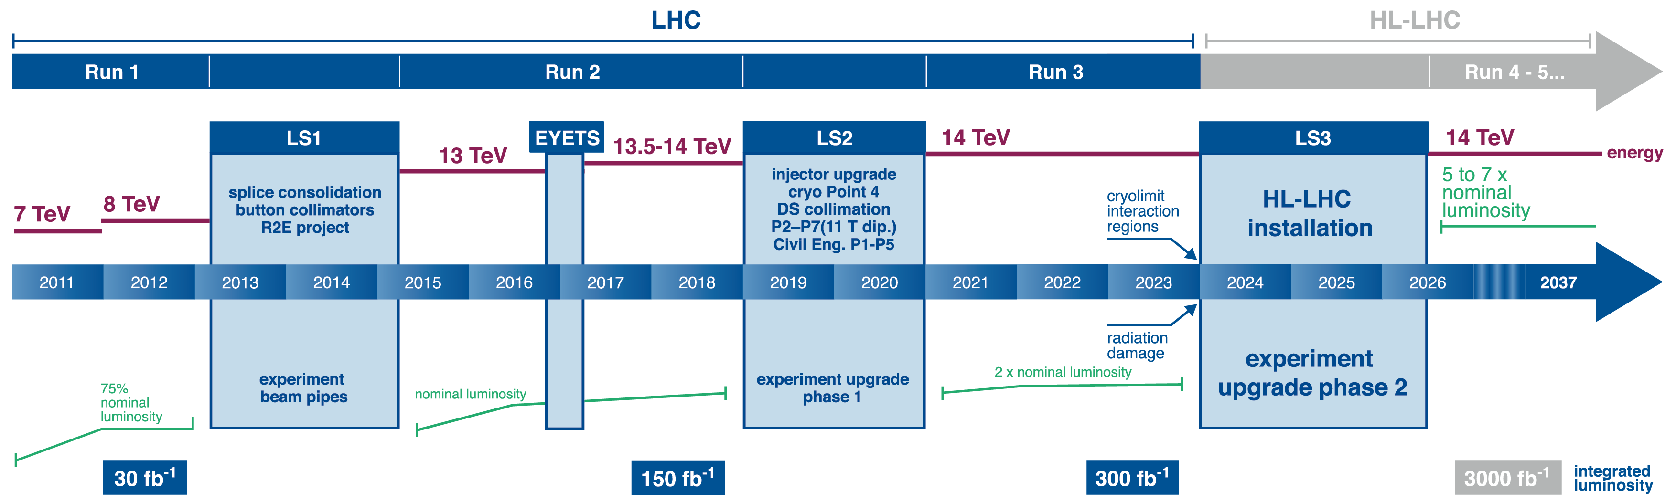
What does the future hold?
Analyzing remaining data from 2016 (35 fb⁻¹ total).
By 2023, this will increase to 300 fb⁻¹. Will greatly expand the reach of our searches for new physics.
After major upgrades of LHC and detectors, will collect 3000 fb⁻¹ from 2026-2037 for another big increase in sensitivity. Upgraded detectors are being designed now.
Also expand searches to include more SUSY parameter space.

Slide 39
Summary
The Higgs particle has been discovered, nearly 50 years after its prediction. This completes the Standard Model.
There are still many open questions in particle physics.
It is hoped that experiments at the LHC will provide some of the answers.
So far we haven’t found any new physics but during the next 20 years, we should collect 100 times more data that may lead to a revolution in our understanding.

Slide 40
Backup

Slide 41
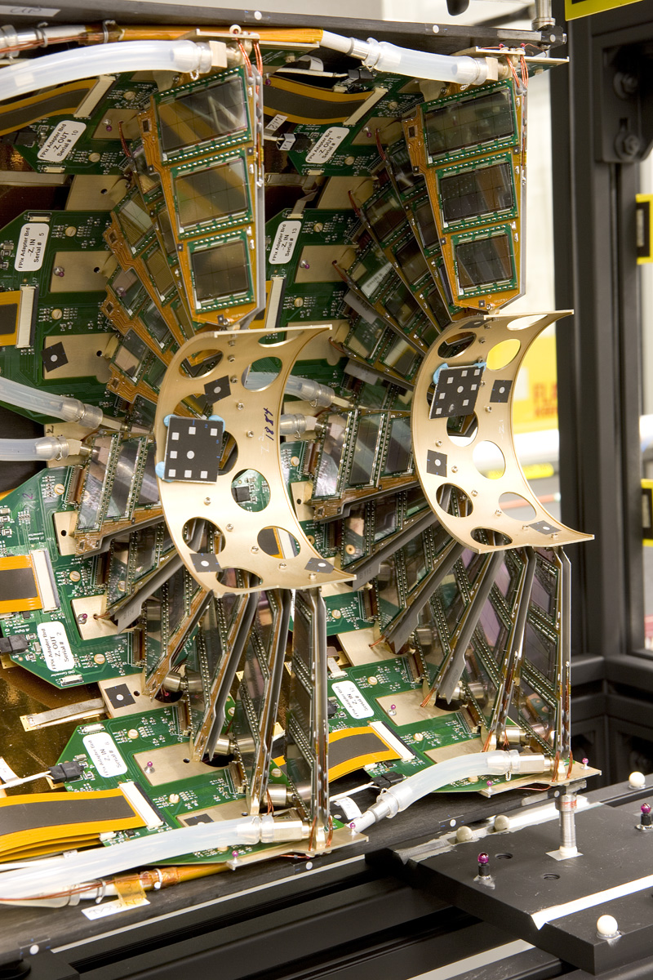
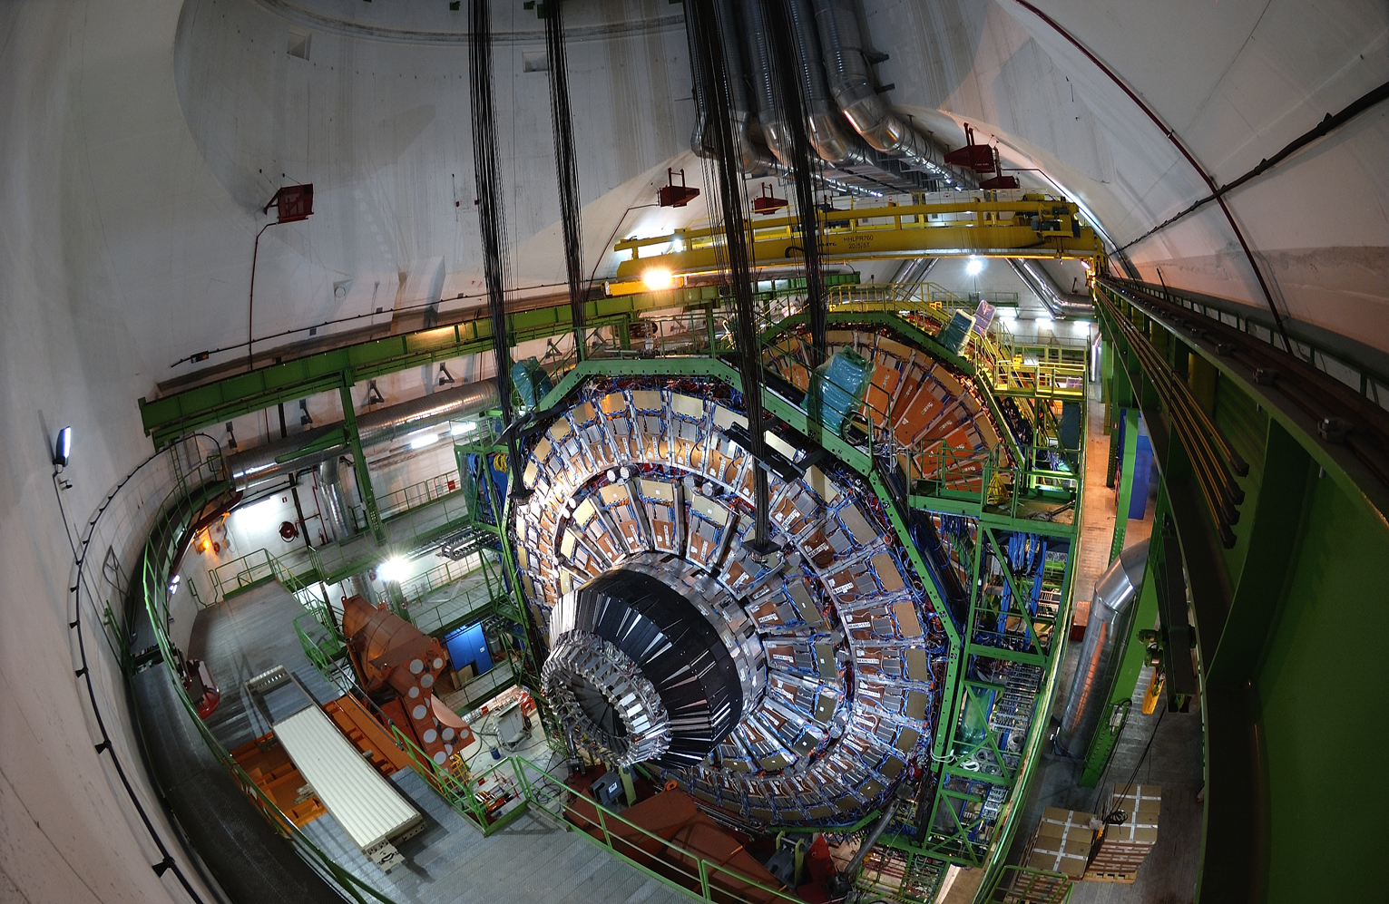
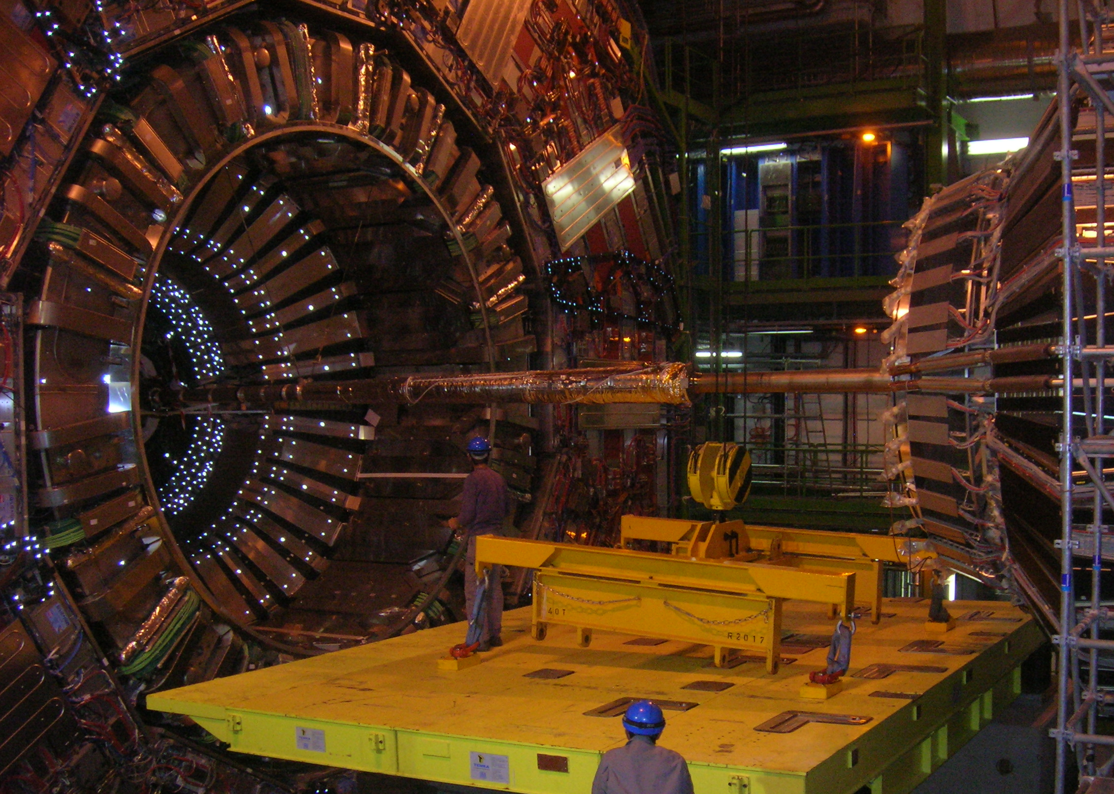
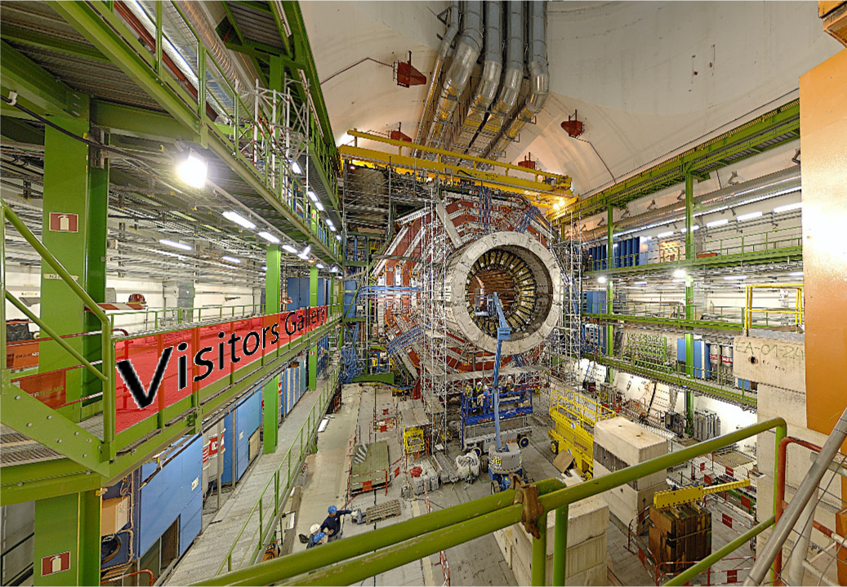
More photos to end on…

Slide 42

Searching for supersymmetry
A few rules for most SUSY searches:
squarks and gluinos are predominantly produced because they couple to the strong force
SUSY particles produced in pairs (R-parity conservation)
Decay cascades end with lightest supersymmetric particle (LSP) which escapes detection.
  Cascades produce jets & leptons (electrons, muons, taus)
  The escape of LSP’s results in missing energy (MET).
These rules suggest search strategies:

Slide 43


Estimate of Z→νν
Reconstruct Z→ee and Z→μμ events to estimate Z→νν. Just need to account for efficiency. Unfortunately, there are more Z→νν events than Z→ee + Z→μμ events so statistically limited.
Can also use photon+jets data sample as the production of photons and Z bosons are very similar (at high energy where the mass of the Z is not relevant). Many more photon events than Z→νν so good statistical accuracy but need to carefully control for production differences.
This analysis uses both methods to estimate the Z→νν background

Slide 44

Possible SUSY event
This event contains 12 jets, 3 b-jets, and large MHT.

Slide 45

Possible SUSY event
This event contains 12 jets, 3 b-jets, and large amount of missing transverse energy. Great candidate for a SUSY event (but most likely not).

Slide 46

Search results
Can look in the more sensitive regions to see what a signal may look like.
Still no sign of SUSY.

Slide 47
Summary of hadronic SUSY searches

Slide 48
Other SUSY searches
There are many other CMS searches for SUSY.
These generally include some number of leptons (e/μ/τ) and/or target more specific models.
Example of electroweak production (instead of strong production) with leptons in the final state.

